Slide 1
LPIC-3 304: Virtualization and High Availability
Variations of Virtual Machine Monitors
Notes:
Welcome - this video is going to go over the different types of vmm or hyper
what are the different types of hypervisor and different implementation of virtualization

Slide 2
Hardware Assisted Virtualization
Hardware Virtual Machine (HVM):
Fully virtualized - Guest OS is unaware that it is virtual
Operating system runs unmodified on the virtual machine
Allows for better portability
Takes advantage of the x86 architecture’s virtualization extensions:
VT-x (Intel)
AMD-v (AMD)
Examples – VMware ESXi, XEN, KVM, Hyper-V
Extended Page Tables (EPT):
Supports the virtualization of physical memory
Provides more efficient use of host memory
Notes:
This type of virtualization is going to take advantage of the underlying hardware's virt extensions
1. the virtual machine believes it is intalled on it's own isolated piece of hardware
2. all the modfications are happening below the guest OS. gets the resorces it needs
3. if there is a need to migrate, no changes are necessary to the OS only consideration is the underlying virtualization software
4. because of the desire to virtualize intel/amd added these virt extensions so that hypervisors could take advantage and run more efficiently
EPT allows hypervisor to work more efficiently with host memory

Slide 3

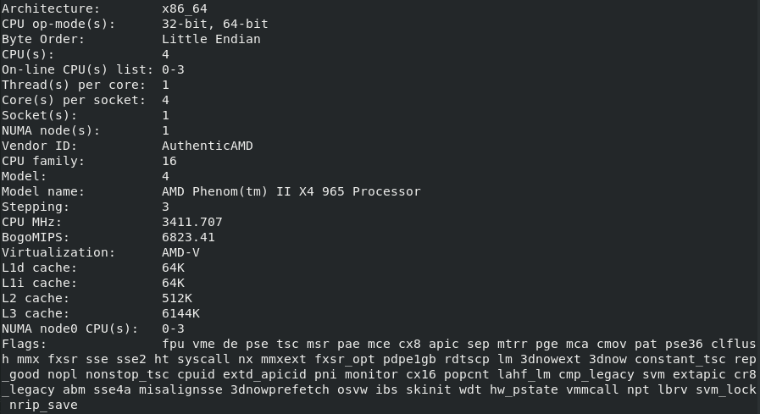
Virtualization Extensions (/proc/cpuinfo)
$ grep --color -E '(svm|vmx)' /proc/cpuinfo
$ lscpu
Notes:
virtualization extensions are not always enabled by default
must be enabled in your system bios (the method to do this can vary). consult the user manual or google the model.
In order to find out whether virt extensions are enabled you must consult /proc/cpuinfo
gives information about cpu but we're mainly concerned with the flags section
--color to make it easier to see and the -E allows you to search using regex (svm or vmx)
another way to query is using lscpu

Slide 4
Paravirtualization
Lightweight virtual technique introduced by the Xen Project team ( https://wiki.xen.org/wiki/Paravirtualization_(PV) )
Guest operating system must be modified (requires kernel support and drivers)
Does not require virtualization extensions
Communicates efficiently with hypervisor (hypercalls) to bypass the performance cost of resource emulation
Offers near-native performance
Notes:
Support for PV are now in the Linux kernel. Guest OS is aware that it’s virtual
support was removed in rhel 6 (affects the upstream projects); howver you can update using the CetntOS extras repos we'll talk about latter, added in base linux kernel so it's supported by many distribution so they support out of the box
Allows OS to recognize the presence of a hypervisor and communicate directly with it (hypercalls).
This is a more efficient means of communication.
Full virtualization relies on hardware emulation.

Slide 5
Container Virtualization (OS-Level Virtualization)
Container is more akin to an application (launched via scripts/templates), but thinks it’s an operating system
Uses only what is necessary to run applications (runtime environment, binaries, libraries, configuration files, etc.)
Uses fewer resources than a virtual machine
Extensions of the host kernel (but completely isolated)
Runs processes natively rather than using emulation
Uses namespaces and cgroups to isolate processes and manage resources
Examples include Docker, LXC, etc.
Notes:
1. high level view, is more like an app.
3. very ligth-weight, since it's only loading what is necessary to run an application
reducis the overhead from installing a full OS (lib/bins)
4. uses built-in linux utilities to make sure that sure that it has restricted acces
5. since it's an isolotated instance of the host processor
6. utilities that are already built into linux. part of the core way linux funcitons

Slide 6
LPIC-3 304: Virtualization and High Availability
Variations of Virtual Machine Monitors

