Slide 1
LPIC-3 304: Virtualization and High Availability
Terminology
Notes:
Welcome – go over some terms and concepts of virtualization
No doubt many of you have already used virtualization in some format or another (whether you were aware of it or not).
It’s good for us to have a base understanding of virtualization and what it’s trying to accomplish. as we begin the virtualization section lpic 304

Slide 2
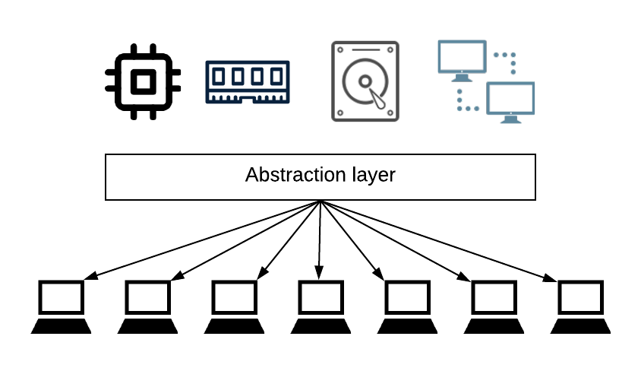
What is virtualization?
Creating a virtual version of something physical
Primary goal of virtualization is dividing physical resources into multiple virtual entities
Includes physical resources like CPU, memory, storage, and network (the “core four”)
Provides an abstraction layer (hypervisor)
Allows different operating systems and distributions to exist on the same hardware
Notes:
We’ve all heard of virtual reality which allows you to interact in a world that is very similar to the physical world
In Regards to computing, the primary goal…
Uses the core for resources
This is accomplished through an abstraction layer hypervisor or vmm
One of the great thing about virt is that it doesn’t tie you down to a particular OS
Caveat x86 arch. Talk about it later on in the vid

Slide 3
Simulation vs Emulation vs Virtualization
Simulation:
    A system that is made to behave like something else. It acts similar to what it is being simulated but does not necessarily adhere to all of the rules.
Emulation:
    A system that is made to be a complete replica of another system. An emulation adheres to the rules of the system being emulated. With emulation, a system that is not compatible with x86 architecture can be made to run on the hardware.
Virtualization:
    Seeks to divide the host resources between multiple guest operating systems. Guest operating systems must be compatible with the host architecture (in this case x86). Modern hypervisors allow code to run as if the operating system was natively installed.
Notes:
Simulation more concerned with the state of something
Emulation is trying to reproduce all the components of that environment
Emulation tends to have a heavy performance penalty.
Emulation seeks to imitate a hardware/software environment that doesn’t exist
Sympath vs empathy ?

Slide 4
x86 Protection Layers
Ring 3 (User Mode): This is where the majority of the code running on your computer is executed. The executing code running in Ring 3 does not have direct access to the underlying hardware.
Ring 1 and 2: This is reserved for device drivers.
Ring 0 (Kernel Mode): The host operating system kernel is here. It has unrestricted access to the underlying hardware.
Ring -1: The hypervisor (or virtual machine monitor) is here. This allows for multiple guest operating systems.
Notes:
Giving multiple operating system kernels access to ring 0 is a recipe for disaster
The Hypervisor sits below ring 0 so that each guest operating system can run as if it was the only OS on the hardware

Slide 5
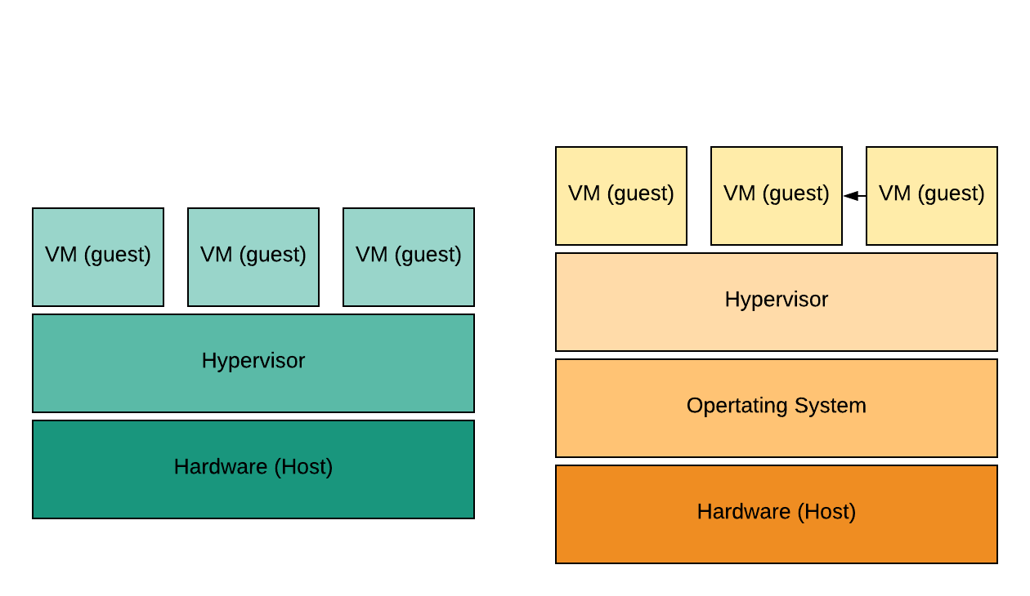
Hypervisor
A hypervisor is a program that allows multiple virtual machines to run on a single piece of hardware.
It redirects requests for resources, like memory and storage, to their virtual equivalents.
Type 1 (native or bare metal) hypervisors sit directly on top of the host hardware, and abstract the hardware from the guest operating systems:
    XenServer, ESXi, Hyper-V
Type 2 (hosted) hypervisors run in the operating system layer as a process:
    Vmware fusion, Oracle Virtual Box
Notes:
The Hypervisor sits below ring 0 so that each guest operating system can run as if it was the only OS on the hardware

Slide 6
LPIC-3 304: Virtualization and High Availability
Terminology

