Slide 1
LPIC-3 304: Virtualization and High Availability
Migration (P2V and V2V)

Slide 2

Migration of Physical to Virtual Machines (P2V)
Includes migrating the operating system, applications, and data from a physical server to a virtual machine
Can be a very difficult and in some cases is not possible
Several applications claim to be able to do this
Choose migration application based on which virtual platform you are migrating to
Manual P2V migration may be the most appealing option:
Manually create virtual machine in the virtualization platform
Copy files from the physical machine (OS files, applications, data, etc.) to the newly created virtual machine
Grab a lucky rabbits foot and cross your fingers!
Notes:
2. older legacy apps and proprietary third party apps. do your research

Slide 3
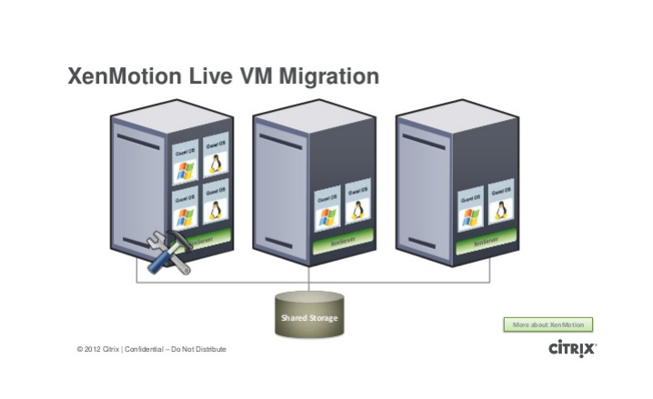
Migration of Virtual Machines between Host systems (V2V)
Most virtualization platforms offer a wide range of operations for disaster recovery and high availability which includes backups and migration.
The migration process can very between virtualization platforms.
Almost all of the major virtualization vendors offer live migration (migrating VMs between host systems within the platform).
Migrating virtual machines from one virtualization platform to another is also possible with standardized virtual machine images.
We will talk more about migration as it pertains to specific platforms later on in the course!
Notes:
Backups/migration/disaster recovery are some of the features that make virtualization so appealing.
Most platforms provide these features, but as you can imagine, the implementation is going to differ.
Virtualization offers command line utilities and graphical interfaces to help with migration

Slide 4
LPIC-3 304: Virtualization and High Availability
Migration (P2V and V2V)

