Slide 1
LPIC-3 304: Virtualization and High Availability
Cloud Computing
Notes:
Welcome - gonna talk about cloud computing
even if you're not part of the IT world you've most likely heard of cloud computing or "the cloud!"

Slide 2
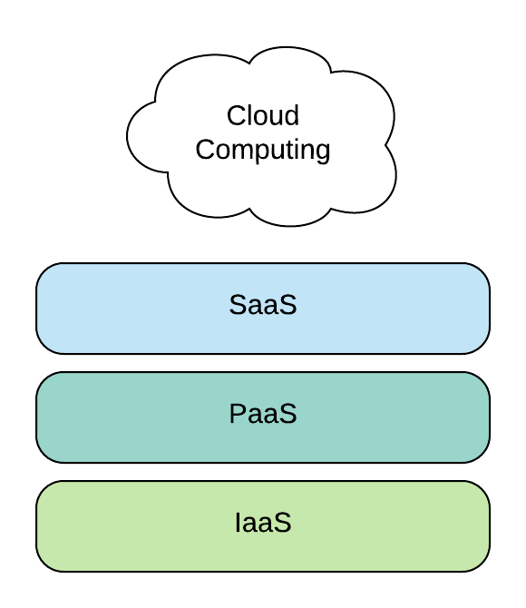
What is cloud computing?
Cloud computing is the use of remote computer services that provide storage, compute resources, network, data, analytics, and even full blown applications
Makes use of virtualization technology
Services are on-demand
Variable expense (Pay-as-you-go) vs capital expense
Cloud providers: Amazon Web Services, Microsoft Azure, Google Cloud Platform
Main cloud computing services
    Infrastructure-as-a-service (IaaS -“ice”)
    Platform-as-a-service (PaaS - “pass”)
    Software-as-a-servie (SaaS - “sass”)
Notes:
2. which makes cloud computing possible
3. meaning you get additional services as you need them.
4. sinking a large amount of your personal or business capital
5. just to list a few but there are many others.
6. these make up cloud computing

Slide 3
Infrastructure-as-a-service (IaaS)
Provides you with remote access to servers which includes compute resources, storage, network, and firewall
A virtual data center
Install, maintain, and configure the software:
    Operating systems
    Middleware
    Applications
    Data
    Runtime
Offers the most flexibility and control over IT resources
Examples – Amazon AWS, Microsoft Azure, Rackspace Open Cloud, Google Compute Engine
Notes:
2. basically is a virtual data center. so rather than setting up and maintaining your own, you can effectively rent what you need.

Slide 4
Platform-as-a-service (PaaS)
Provides the tools to develop and deploy applications quickly
Includes the underlying infrastructure required to run and deploy applications, but removes the need to build and maintain the underlying infrastructure:
    System/Software updates
    Resource management
    Capacity planning
Provides analytics for applications, in addition to a development framework
Examples – AWS Elastic Beanstalk, Salesforce, Microsoft Azure, Red Hat OpenShift, Google App Engine

Slide 5
Software-as-a-service (SaaS)
Provides a complete solution that does not require management of the software or hardware
Saves time and money on in-house development and maintenance
Sophisticated, end-user, cloud-based applications
Examples – Microsoft Office 365, Google G Suite, Dropbox
Notes:
2. you can just purchase applications that are needed for your business
3. most of you have probably already used and are currently using SaaS
4. if you're using gmail you are using a SaaS
several different cloud offerings but most will fall into one of these three categories

Slide 6
LPIC-3 304: Virtualization and High Availability
Cloud Computing
Notes:
Sometimes it can be hard to disitinguish between different cloud offerings but i hope this video has given you better understanding on what cloud computing consists of.

